Slide 1



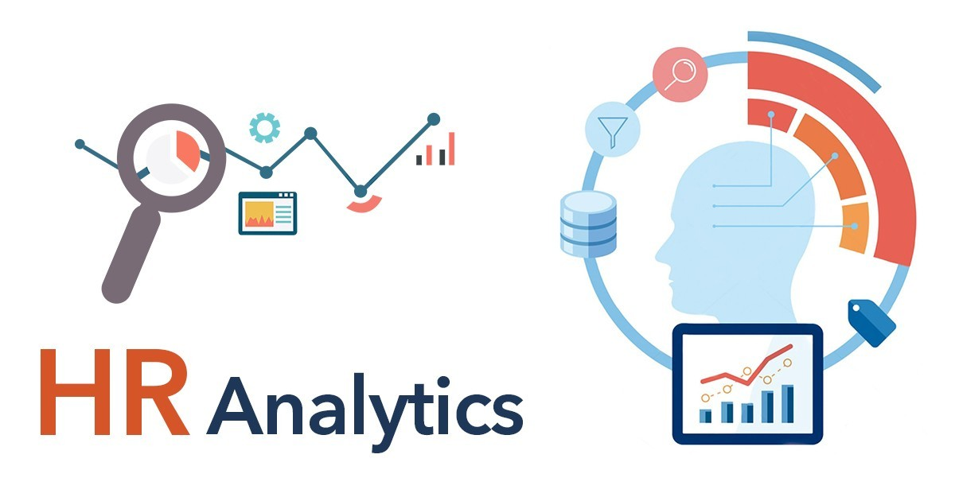
HR Data analysis
Presented by
Guided by
Yaswanth
Rosannagari
Siddhant Sharma

Slide 2
Content
Abstract
SQL Objective on data
Queries on SQL analysis
Python Objectives
Tools and technologies
Testing / EDA on Data
Model preparation / Model Evaluation
Overview on Python analysis
Power BI
Dashboard on Power BI with Overview
Conclusion
HR Data analysis
2

Slide 3
KPIs_met >80% 0.221582 awards_won? 0.195871 avg_training_score
KPIs_met >80% 0.221582 awards_won? 0.195871 avg_training_score
1. Abstract
This project focused on predicting employee promotions using SQL, Python, and Power BI.
SQL was used to organize data, including employee details like department, education, and performance metrics.
Python's Exploratory Data Analysis (EDA) helped uncover patterns and clean the data. We then built a classification model to predict promotions based on features like KPIs_met >80%, awards won, avg_training_score.
In last, a Power BI dashboard presented our findings clearly.
This structured approach provided actionable insights for HR department to make informed decisions regarding employee promotions.
HR Data analysis
3

Slide 4
SQL Objective on data
Using SQL, created the database named “last_project”, utilized it in performing various queries on the table created ‘Himanshu’.
SQL helped in performing operations such as count of employees w.r.t. region, department and determining highest previous year ratings by department.
It also lists employees who met specific performance criteria and identifies below-average training scores by department. Using CTEs for departmental statistics, and ranks employees by training scores within departments.
The queries provide a comprehensive analysis of employee data for insightful decision-making.
Software used : MS SQL and MYSQL
HR Data analysis
4

Slide 5
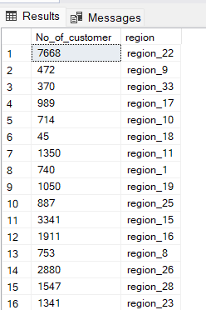
Objectives
Objective 1 :- Display the region wise no of employees.
Functions Used : Count, AS , Group BY
Overview : The query provides a summary of the customer distribution across different regions, allowing for an analysis of customer concentration in various geographic areas.
Code
select count(*) as No_of_customer, region from Himanshu group by region; --
Result :

Slide 6
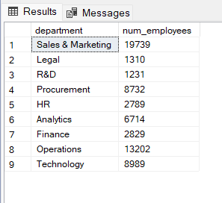
Objectives
Objective 2 :- How many employees are there in each department?
Functions Used : Count, AS , Group BY
Overview : The query produces a summary table where each row corresponds to a department and includes the department name and the count of employees in that department.
Code
SELECT department, COUNT(*) AS num_employees FROM Himanshu GROUP BY department;--
Result :

Slide 7
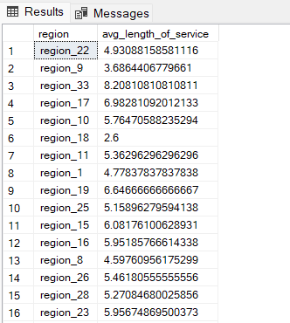
Objectives
Objective 3 :- What is the average length of service for employees in each region?
Functions Used : Count, AS , Group BY, AVG
Overview : The query produces a summary table where each row corresponds to a department and includes the This query will return a table where each row represents a region and includes the average length of service for employees in that region.
Code
SELECT region, AVG(length_of_service) AS avg_length_of_service FROM Himansh GROUP BY region;--
Result :

Slide 8
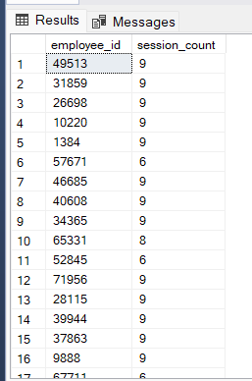
Objectives
Objective 4 :- Which employees have attended more than one training session?
Functions Used : Count, AS , Group BY, Having
Overview :This Query will return a list no of employee_id for employees who have attended more than one training session , along with the count of session they attended
Code
SELECT employee_id, COUNT(no_of_trainings) AS session_count FROM himanshu GROUP BY employee_id HAVING COUNT(no_of_trainings) > 1;
Result :

Slide 9
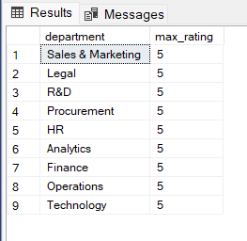
Objectives
Objective 5 :- Find Employees with the Highest Previous Year Ratings in each Department?
Functions Used : Count, AS , Group BY, MAX
Overview :This query will return a table where each row represents a department and includes the maximum rating from the previous year for that department.
Code :
SELECT department, MAX(previous_year_rating) AS max_rating FROM Himanshu GROUP BY department;
Result :

Slide 10
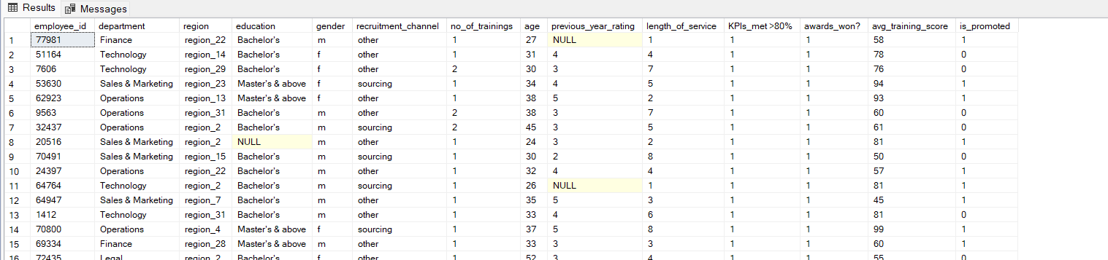
Objectives
Objective 6 :- List Employees Who Have Met KPIs >80% and Won Awards:
Functions Used : AND, Where
Overview :This query will return all columns for employees who have met more than 80% of their KPIs and have won awards.
Code :
SELECT * FROM Himanshu WHERE "KPIs_met >80%" = 1 AND [awards_won?] = 1;
Result :

Slide 11
Objectives
Objective 6 :- List Employees Who Have Met KPIs >80% and Won Awards:
Functions Used : AND, Where
Overview :This query will return all columns for employees who have met more than 80% of their KPIs and have won awards.
Code :
SELECT * FROM Himanshu WHERE "KPIs_met >80%" = 1 AND [awards_won?] = 1;
Result :

Slide 12
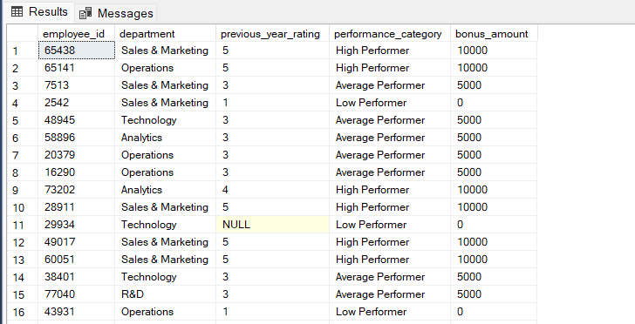
Objectives
Objective 7 :- Calculate Bonus Based on Performance:
Functions Used : Case function with condition.
Overview : The query will provide a list of employees with employee_id, department , performance_category ,allowing you to easily see their performance classification and corresponding bonus..
Code :
SELECT employee_id, department, previous_year_rating,CASE WHEN previous_year_rating >= 4.0 THEN 'High Performer’
WHEN previous_year_rating = 3.0 THEN 'Average Performer' ELSE 'Low Performer' END AS performance_category,
CASE WHEN previous_year_rating >= 4.0 THEN 10000 WHEN previous_year_rating = 3.0 THEN 5000 ELSE 0
END AS bonus_amount FROM Himanshu;
Result :

Slide 13
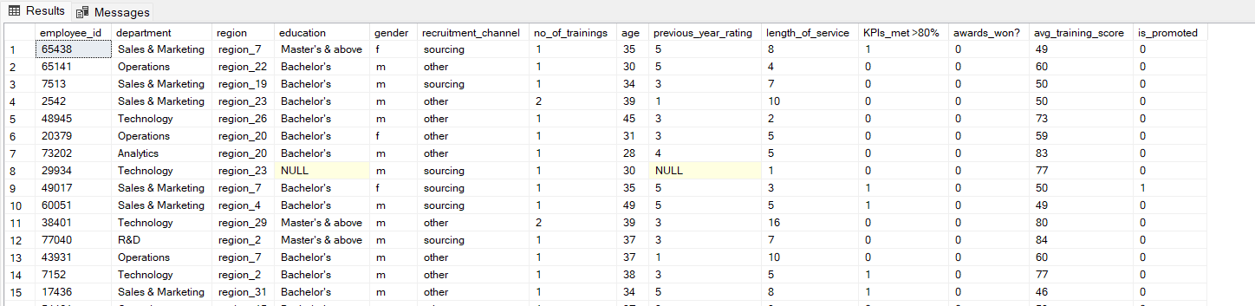
Objectives
Objective 8 :- Identify Employees with Below Average Training Scores by Department:
Functions Used : Where, SubQuery
Overview : It helps identify employees who may need additional training or support compared to their peers within the same department...
Code :
SELECT * FROM Himanshu e WHERE avg_training_score < ( SELECT AVG(avg_training_score)from Himanshu
WHERE department = e.department);
Result :

Slide 14
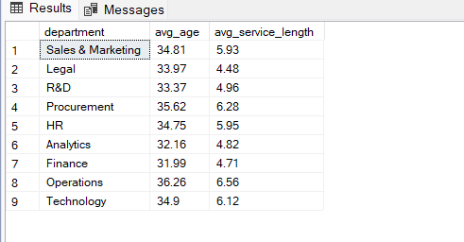
Objectives
Objective 9 :- Calculate Average Age and Length of Service by Department:
Functions Used : CTE, AVG, Group BY , Condition as CTE , ROUND
Overview : This query provides a summary table showing the average age and average length of service for each department. It can be useful for understanding demographic and tenure trends within different departments of the organization.
Code :
WITH department_stats AS (SELECT department, ROUND(AVG(age),2) AS avg_age, ROUND(AVG(length_of_service),2) AS avg_service_length
FROM Himanshu GROUP BY department)SELECT * FROM department_stats;
Result :

Slide 15
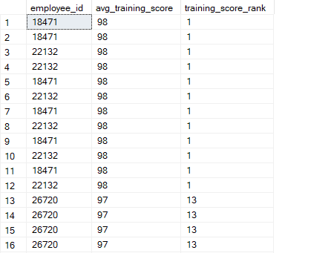
Objectives
Objective 10 :- Window Function to Rank Employees by Average Training Score within Each Department
Functions Used : RANK, PARTITION BY, Order By, DESC
Overview : This query ranks employees based on their average training scores within their respective departments. The rank is assigned such that the highest training score gets the rank of 1 within each department..
Code :
SELECT employee_id,avg_training_score,,
RANK() OVER (PARTITION BY department ORDER BY avg_training_score DESC) AS training_score_rank
FROM Himanshu;
Result :

Slide 16
Overview on SQL analysis
The SQL file focuses on the last_project database, analyzing the Himanshu table to provide detailed employee insights. It counts employees by region and department and calculates the average length of service by region.
It identifies employees with multiple training sessions, those with the highest previous year ratings by department, and those meeting KPIs over 80% and winning awards.
The file also calculates performance-based bonuses and identifies employees with below-average training scores by department. Using Common Table Expressions (CTEs) and window functions, it provides average age and service length by department and ranks employees by training scores.
These analyses offer a comprehensive view of employee distribution, performance, and training effectiveness, aiding in trend identification and informed decision-making.
HR Data analysis
16

Slide 17
Python Objectives
Python project focused on predicting employee promotions using various machine learning models.
The project involves data preprocessing, feature selection, and the implementation of multiple models, including Random Forest, Gradient Boosting, and XGBoost.
The notebook includes steps to train these models, evaluate their performance using metrics like confusion matrices, and generate predictions for a test dataset. Visualizations are also included to compare the performance of different models.
The final output is prepared for submission by saving predictions to a CSV file.
This comprehensive approach demonstrates the application of machine learning techniques to a practical business problem, highlighting the entire workflow from data handling to model evaluation and prediction.
HR Data analysis
17

Slide 18
Tools and technologies
This Python project leverages several key tools for predicting employee promotions. *Pandas* and *NumPy* are utilized for data manipulation and numerical operations.
*Scikit-learn* is the primary library for machine learning, offering tools for data preprocessing, model training, and evaluation, including Random Forest and Gradient Boosting. *XGBoost* is employed for optimized gradient boosting.
*Matplotlib* and *Seaborn* are used for creating visualizations to understand data distributions and model performance.
These tools collectively enable comprehensive data handling, robust model development, and insightful visualizations, facilitating a thorough analysis of the promotion prediction problem.
HR Data analysis
Month - Year
18

Slide 19
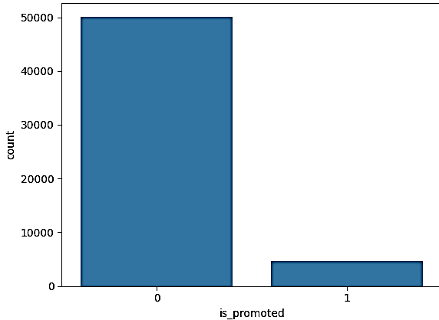
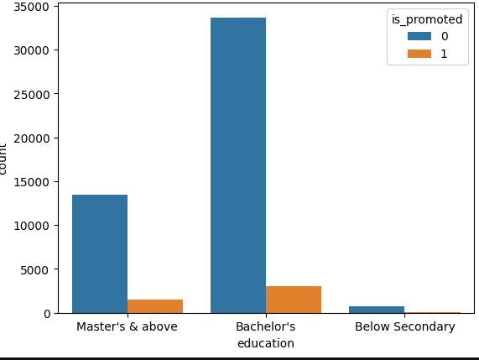
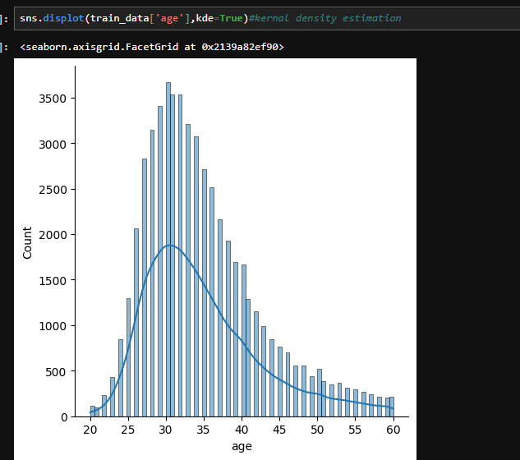
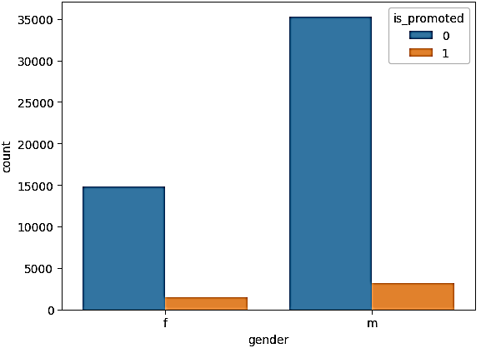
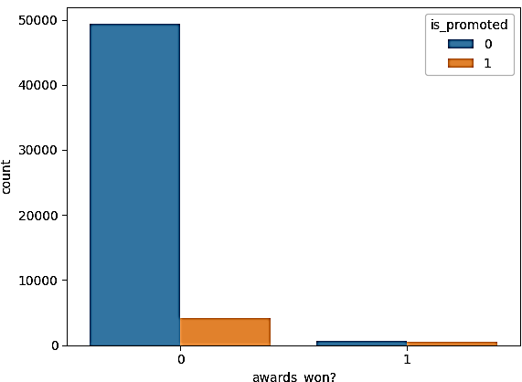
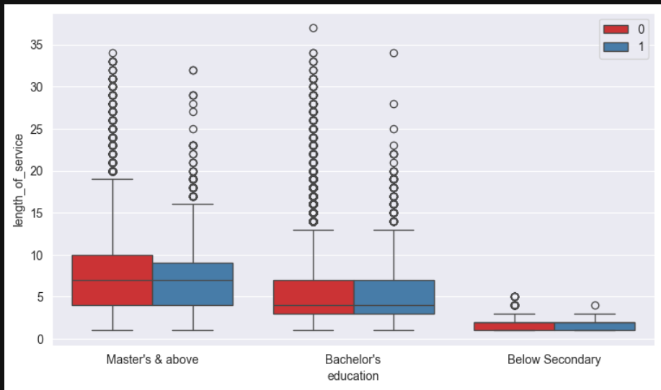
EDA Portion

Slide 20
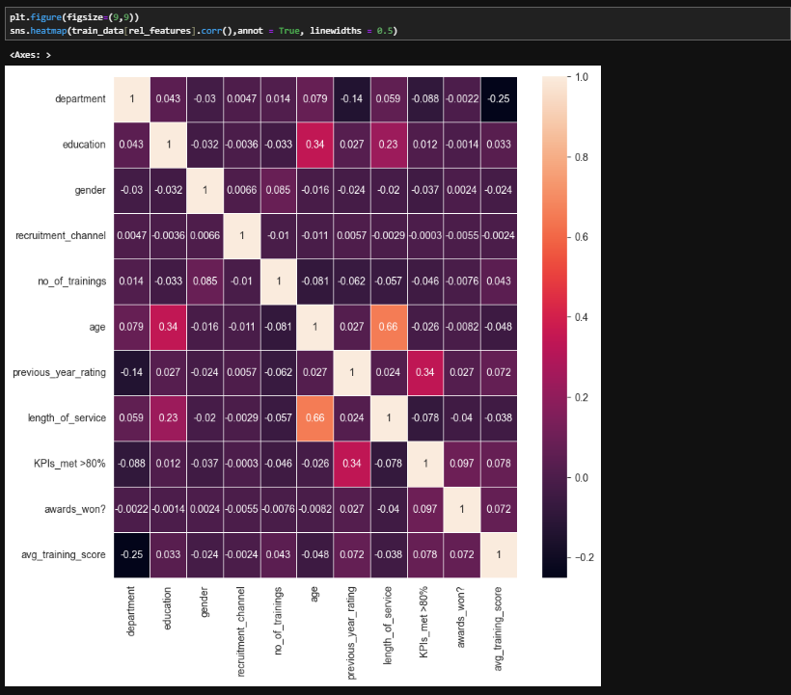
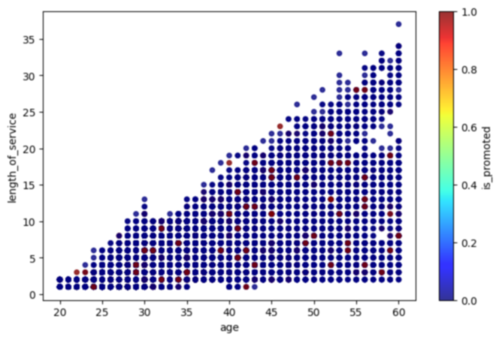
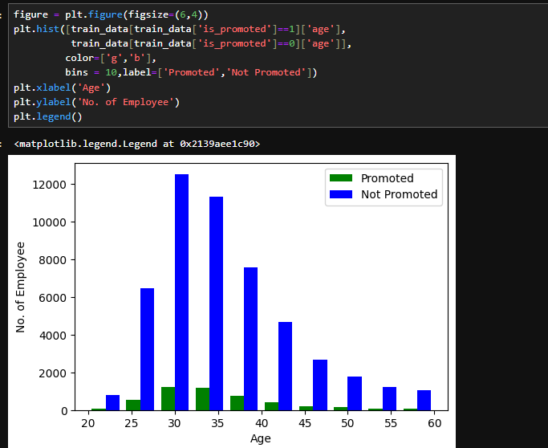
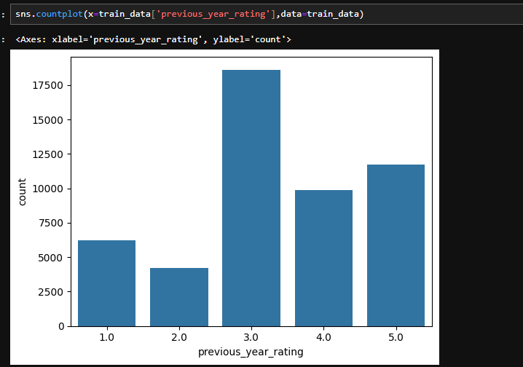
Plots & heatmap for correlation b/w features

Slide 21
Testing / EDA on Data
The Exploratory Data Analysis (EDA) part of this Python project focuses on understanding the underlying patterns and relationships in the dataset related to employee promotions.
Using *Pandas, the data is initially loaded and inspected to identify any missing values, outliers, or inconsistencies. Descriptive statistics are computed to summarize the central tendency, dispersion, and shape of the dataset’s distribution.
**Seaborn* and *Matplotlib* are then employed to create visualizations such as histograms, box plots, and scatter plots, which help in identifying correlations between features and the target variable.
These insights guide feature selection and engineering, ensuring that the data is appropriately preprocessed for the subsequent modeling phase
HR Data analysis
21

Slide 22
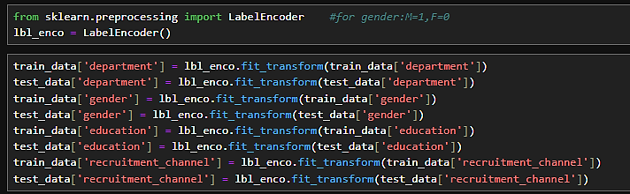
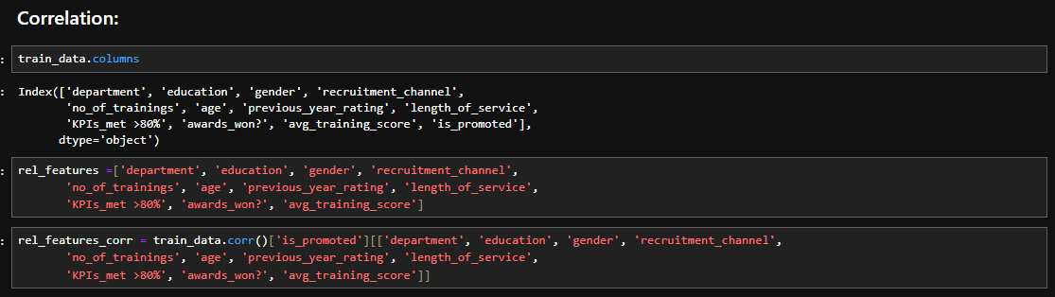
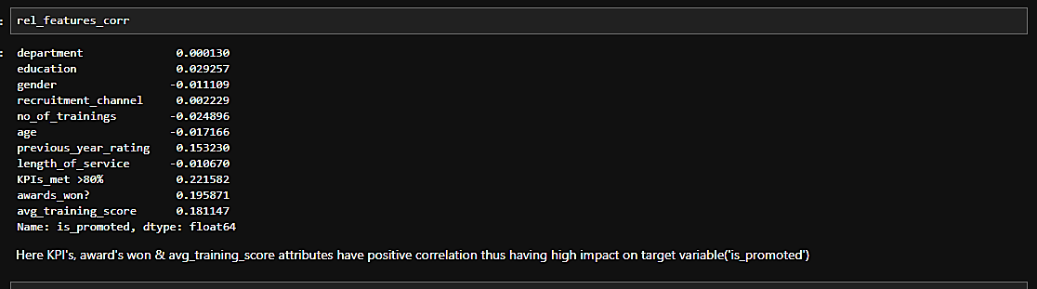
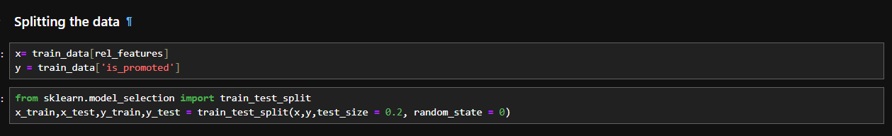
Model preparation / Model Evaluation
HR Data analysis
22

Slide 23
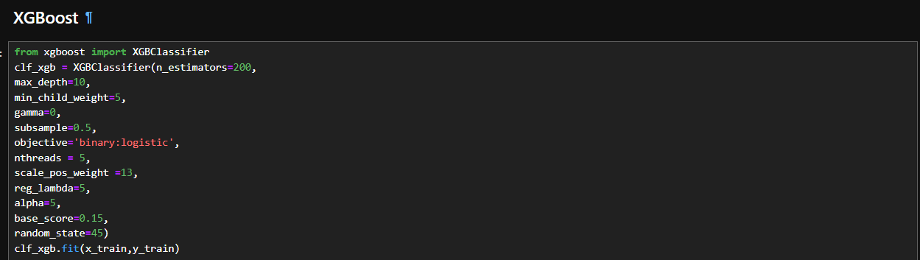
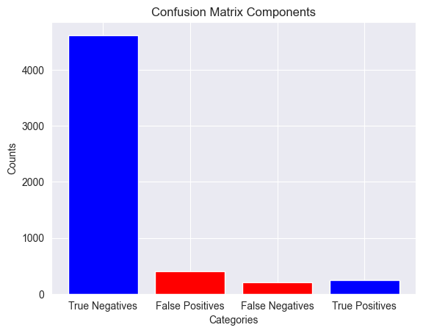
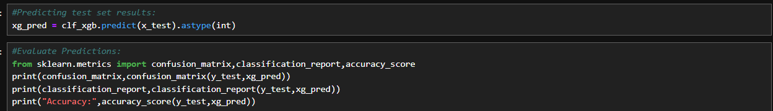
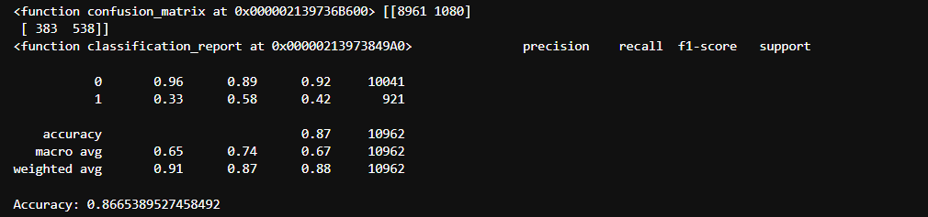
XGBoost classifier model

Slide 24
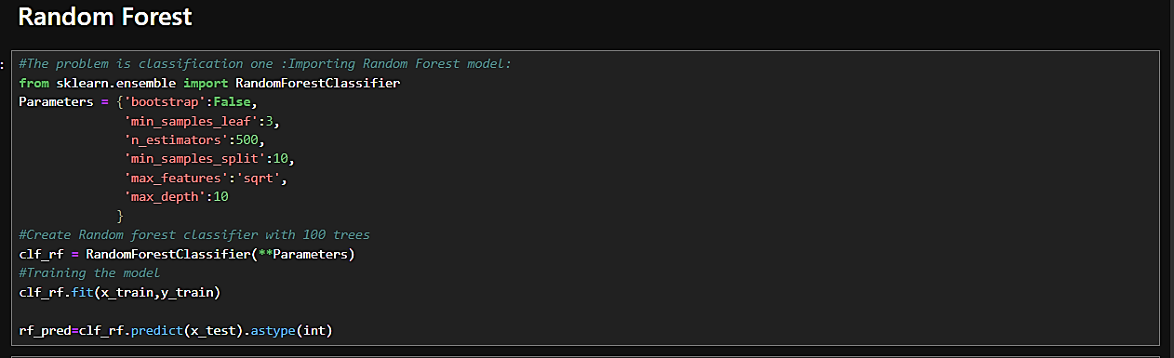
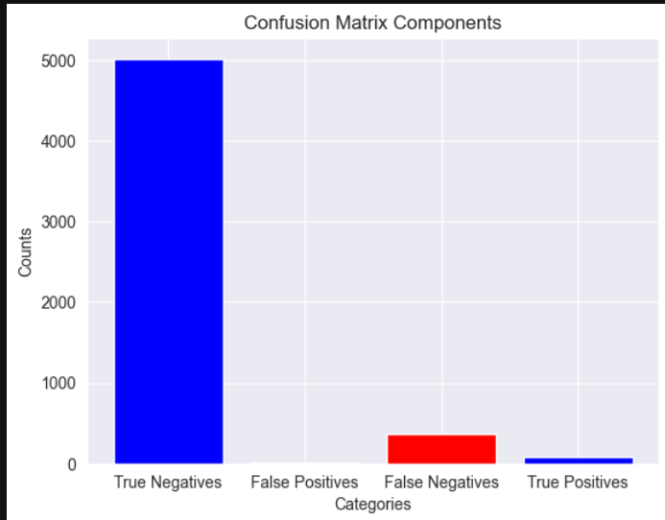
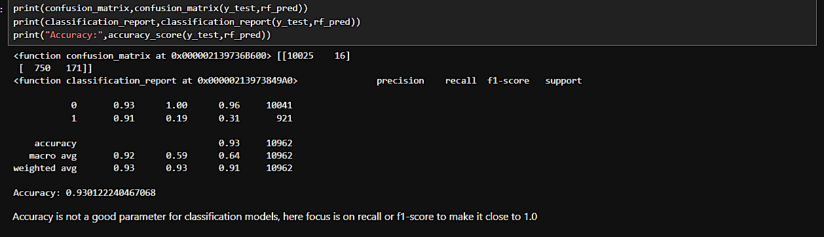
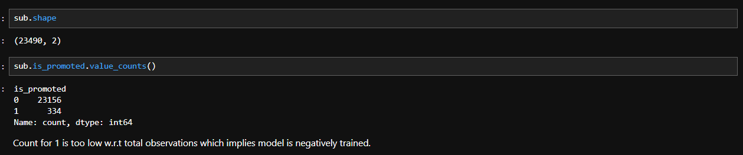
Random Forest Model

Slide 25
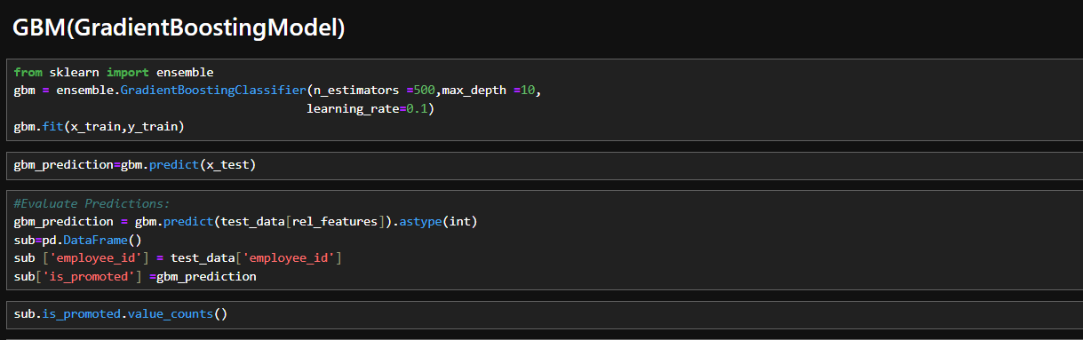
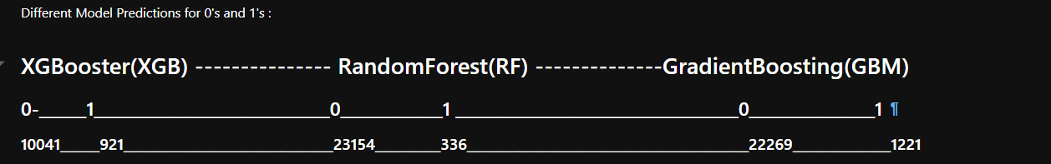
GBM Model

Slide 26
Overview on Python analysis
During the model training and evaluation phase, the project utilized a machine learning classifier to predict employee promotions based on various features such as department, region, education, gender, recruitment channel, number of trainings, age, previous year rating, length of service, KPIs met, awards won, and average training score.
Initially, the training data was split into training and validation sets to assess the model's performance on unseen data.
After transforming categorical variables into numerical labels, the chosen classifier was trained on the prepared dataset.
The model's performance was then evaluated using metrics such as accuracy, precision, recall, and F1 score to ensure its effectiveness.
Finally, the trained model was employed to make predictions on the test data, providing insights into potential employee promotions.
HR Data analysis
26

Slide 27
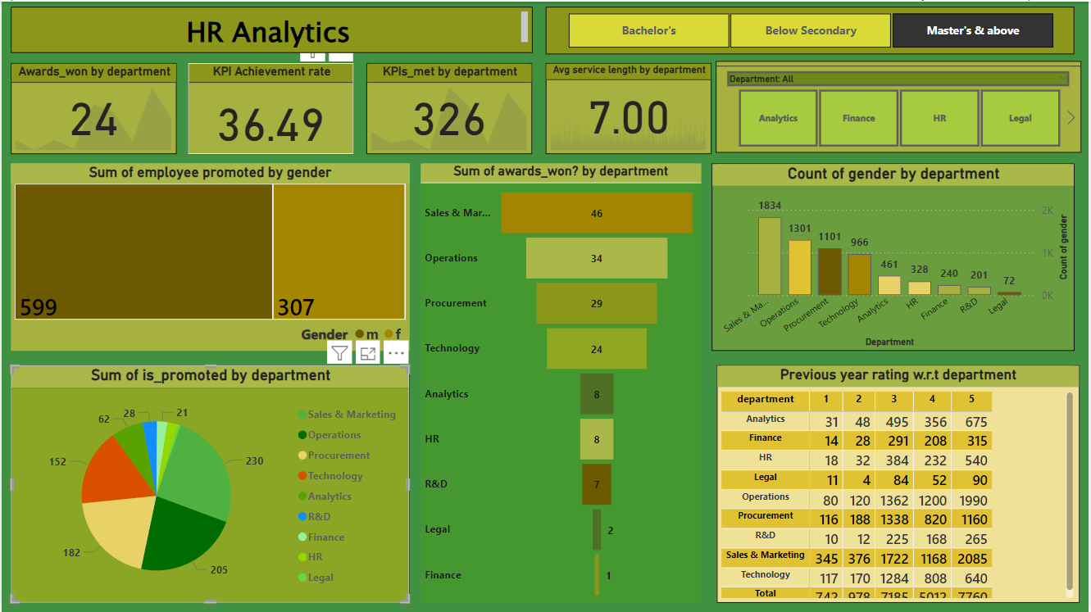
Power BI Dashboard
HR Data analysis
27

Slide 28
Dashboard on Power BI with Overview
The HR dashboard provides a comprehensive overview of key employee metrics, performance indicators, and promotion predictions.
It is designed to aid HR professionals in making informed decisions by visualizing essential data points.
The dashboard includes visualizations of employee demographics, such as distributions across departments, regions, and education levels. It also highlights performance metrics, including average training scores, KPIs met, and awards won.
Furthermore, the dashboard presents model predictions for employee promotions, allowing users to identify high-potential employees and assess the effectiveness of training programs.
By integrating these elements, the dashboard serves as a powerful tool for strategic HR management and decision-making.
HR Data analysis
28

Slide 29
Conclusion
The HR dashboard project successfully integrates extensive data preprocessing, robust model training, and insightful visualization to enhance strategic decision-making.
Leveraging libraries like pandas, matplotlib, and seaborn for data handling and visualization, and employing machine learning models for accurate promotion predictions, the project demonstrates a comprehensive approach to HR analytics.
The dashboard effectively presents key employee metrics, performance indicators, and promotion likelihoods, enabling HR professionals to make data-driven decisions. Overall, this project exemplifies the power of data analytics in optimizing
HR processes and improving organizational outcomes.
HR Data analysis
29

Slide 30


